Slide 1
Performance Evaluation of Information Retrieval Systems
Many slides in this section are adapted from Prof. Joydeep Ghosh (UT ECE) who in turn adapted them from Prof. Dik Lee (Univ. of Science and Tech, Hong Kong)

Slide 2
Why System Evaluation?
There are many retrieval models/ algorithms/ systems, which one is the best?
What is the best component for:
Ranking function (dot-product, cosine, …)
Term selection (stopword removal, stemming…)
Term weighting (TF, TF-IDF,…)
How far down the ranked list will a user need to look to find some/all relevant documents?

Slide 3
Difficulties in Evaluating IR Systems
Effectiveness is related to the relevancy of retrieved items.
Relevancy is not typically binary but continuous.
Even if relevancy is binary, it can be a difficult judgment to make.
Relevancy, from a human standpoint, is:
Subjective: Depends upon a specific user’s judgment.
Situational: Relates to user’s current needs.
Cognitive: Depends on human perception and behavior.
Dynamic: Changes over time.

Slide 4
Human Labeled Corpora (Gold Standard)
Start with a corpus of documents.
Collect a set of queries for this corpus.
Have one or more human experts exhaustively label the relevant documents for each query.
Typically assumes binary relevance judgments.
Requires considerable human effort for large document/query corpora.

Slide 5
Precision and Recall
retrieved & irrelevant
Not retrieved & irrelevant
Entire document collection
irrelevant
Relevant documents
Retrieved documents
retrieved & relevant
not retrieved but relevant
relevant
retrieved
not retrieved

Slide 6
Precision and Recall
Precision
The ability to retrieve top-ranked documents that are mostly relevant.
Recall
The ability of the search to find all of the relevant items in the corpus.

Slide 7
Determining Recall is Difficult
Total number of relevant items is sometimes not available:
Sample across the database and perform relevance judgment on these items.
Apply different retrieval algorithms to the same database for the same query. The aggregate of relevant items is taken as the total relevant set.

Slide 8
Trade-off between Recall and Precision
Returns relevant documents but
misses many useful ones too
The ideal
1
Precision
0
1
Recall
Returns most relevant
documents but includes
lots of junk

Slide 9
Computing Recall/Precision Points
For a given query, produce the ranked list of retrievals.
Adjusting a threshold on this ranked list produces different sets of retrieved documents, and therefore different recall/precision measures.
Mark each document in the ranked list that is relevant according to the gold standard.
Compute a recall/precision pair for each position in the ranked list that contains a relevant document.

Slide 10
Computing Recall/Precision Points: Example 1
Let total # of relevant docs = 6
Check each new recall point:
R=1/6=0.167; P=1/1=1
R=2/6=0.333; P=2/2=1
R=3/6=0.5; P=3/4=0.75
R=4/6=0.667; P=4/6=0.667
Missing one
relevant document.
Never reach
100% recall
R=5/6=0.833; p=5/13=0.38

Slide 11
Computing Recall/Precision Points: Example 2
Let total # of relevant docs = 6
Check each new recall point:
R=1/6=0.167; P=1/1=1
R=2/6=0.333; P=2/3=0.667
R=3/6=0.5; P=3/5=0.6
R=4/6=0.667; P=4/8=0.5
R=5/6=0.833; P=5/9=0.556
R=6/6=1.0; p=6/14=0.429

Slide 12
Interpolating a Recall/Precision Curve
Interpolate a precision value for each standard recall level:
r_{j} ∈{0.0, 0.1, 0.2, 0.3, 0.4, 0.5, 0.6, 0.7, 0.8, 0.9, 1.0}
r₀ = 0.0, r₁ = 0.1, …, r₁₀=1.0
The interpolated precision at the j-th standard recall level is the maximum known precision at any recall level between the j-th and (j + 1)-th level:

Slide 13
Interpolating a Recall/Precision Curve: Example 1
Precision
1.0
0.8
0.6
0.4
0.2
0.2
0.4
0.6
0.8
1.0
Recall

Slide 14
Interpolating a Recall/Precision Curve: Example 2
Precision
1.0
0.8
0.6
0.4
0.2
0.2
0.4
0.6
0.8
1.0
Recall

Slide 15
Average Recall/Precision Curve
Typically average performance over a large set of queries.
Compute average precision at each standard recall level across all queries.
Plot average precision/recall curves to evaluate overall system performance on a document/query corpus.

Slide 16
Compare Two or More Systems
The curve closest to the upper right-hand corner of the graph indicates the best performance

Slide 17
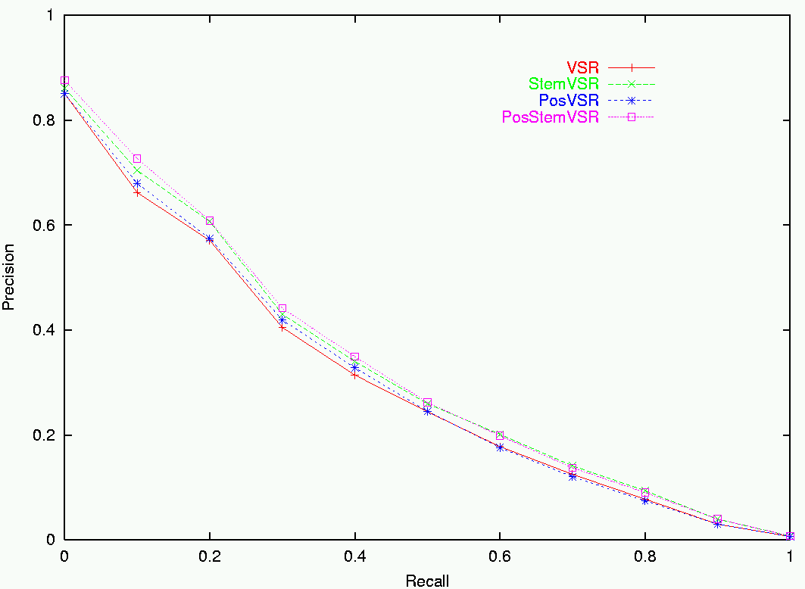
Sample RP Curve for CF Corpus

Slide 18
R- Precision
Precision at the R-th position in the ranking of results for a query that has R relevant documents.
R = # of relevant docs = 6
Position 6
R-Precision = 4/6 = 0.67

Slide 19
F-Measure
One measure of performance that takes into account both recall and precision.
Harmonic mean of recall and precision:
Compared to arithmetic mean, both need to be high for harmonic mean to be high.

Slide 20
E Measure (parameterized F Measure)
A variant of F measure that allows weighting emphasis on precision over recall:
Value of β controls trade-off:
β = 1: Equally weight precision and recall (E=F).
β > 1: Weight recall more.
β < 1: Weight precision more.

Slide 21
Mean Average Precision (MAP)
Average Precision: Average of the precision values at the points at which each relevant document is retrieved.
Ex1: (1 + 1 + 0.75 + 0.667 + 0.38 + 0.001)/6 = 0.633
Ex2: (1 + 0.667 + 0.6 + 0.5 + 0.556 + 0.429)/6 = 0.625
Mean Average Precision: Average of the average precision value for a set of queries.

Slide 22
MEAN Average Precision (over multiple rankings)

Slide 23
Notes on MAP
If a relevant document never gets retrieved, we assume the precision corresponding to that relevant doc to be zero
MAP is macro-averaging: each query counts equally
Now perhaps most commonly used measure in research papers
Good for web search?
MAP assumes user is interested in finding many relevant documents for each query
MAP requires many relevance judgments in text collection

Slide 24
Non-Binary Relevance
Documents are rarely entirely relevant or non-relevant to a query
Many sources of graded relevance judgments
Relevance judgments on a 5-point scale
Multiple judges
Click distribution and deviation from expected levels (but click-through != relevance judgments)

Slide 25
Cumulative Gain
With graded relevance judgments, we can compute the gain at each rank.
Cumulative Gain at rank n:
(Where rel_{i} is the graded relevance of the document at position i)

Slide 26
Discounted Cumulative Gain
Popular measure for evaluating web search and related tasks
Two assumptions:
Highly relevant documents are more useful than marginally relevant documents
the lower the ranked position of a relevant document, the less useful it is for the user, since it is less likely to be examined

Slide 27
Discounting Based on Position
Users care more about high-ranked documents, so we discount results by 1/log₂(rank)
Discounted Cumulative Gain:

Slide 28
An Ideal Rank w.r.t Graded Relevance
The ideal ranking would first return the documents with the highest relevance level, then the next highest relevance level, etc

Slide 29
Normalized Discounted Cumulative Gain (NDCG)
To compare DCGs, normalize values so that an ideal ranking would have a Normalized DCG of 1.0
Ideal ranking:

Slide 30
Normalized Discounted Cumulative Gain (NDCG)
Normalize by DCG of the ideal ranking:
NDCG ≤ 1 at all ranks
NDCG is comparable across different queries

Slide 31
Issues with Relevance
Marginal Relevance: Do later documents in the ranking add new information beyond what is already given in higher documents?
A document can be redundant even if it is highly relevant
Duplicates
The same information from different sources
Choice of retrieved set should encourage diversity and novelty.
Coverage Ratio: The proportion of relevant items retrieved out of the total relevant documents known to a user prior to the search.
Relevant when the user wants to locate documents which they have seen before (e.g., the budget report for Year 2000).

Slide 32
Other Factors to Consider
User effort: Work required from the user in formulating queries, conducting the search, and screening the output.
Response time: Time interval between receipt of a user query and the presentation of system responses.
Form of presentation: Influence of search output format on the user’s ability to utilize the retrieved materials.
Collection coverage: Extent to which any/all relevant items are included in the document corpus.

Slide 33
A/B Testing at Web Search Engines
Purpose: Test a single innovation
Prerequisite: You have a large search engine up and running.
Have most users use old system
Divert a small proportion of traffic (e.g., 1%) to the new system that includes the innovation
Evaluate with an “automatic” measure like clickthrough on first result
Now we can directly see if the innovation does improve user happiness.
Probably the evaluation methodology that large search engines trust most
In principle less powerful than doing a multivariate regression analysis, but easier to understand

Slide 34
Experimental Setup for Benchmarking
Analytical performance evaluation is difficult for document retrieval systems because many characteristics such as relevance, distribution of words, etc., are difficult to describe with mathematical precision.
Performance is measured by benchmarking. That is, the retrieval effectiveness of a system is evaluated on a given set of documents, queries, and relevance judgments.
Performance data is valid only for the environment under which the system is evaluated.

Slide 35
Benchmarks
A benchmark collection contains:
A set of standard documents and queries/topics.
A list of relevant documents for each query.
Standard collections for traditional IR:
Smart collection: ftp://ftp.cs.cornell.edu/pub/smart
TREC: http://trec.nist.gov/
Retrieved result
Precision and recall
Standard document collection
Algorithm under test
Evaluation
Standard queries
Standard result

Slide 36
Recap
Benchmarks consist of
Document collection
Query set
Assessment methodology
Assessment methodology can use raters, user clicks, or a combination
These get quantized into a goodness measure – Precision/NDCG etc.
Different engines/algorithms compared on a benchmark together with a goodness measure

